Slide 1

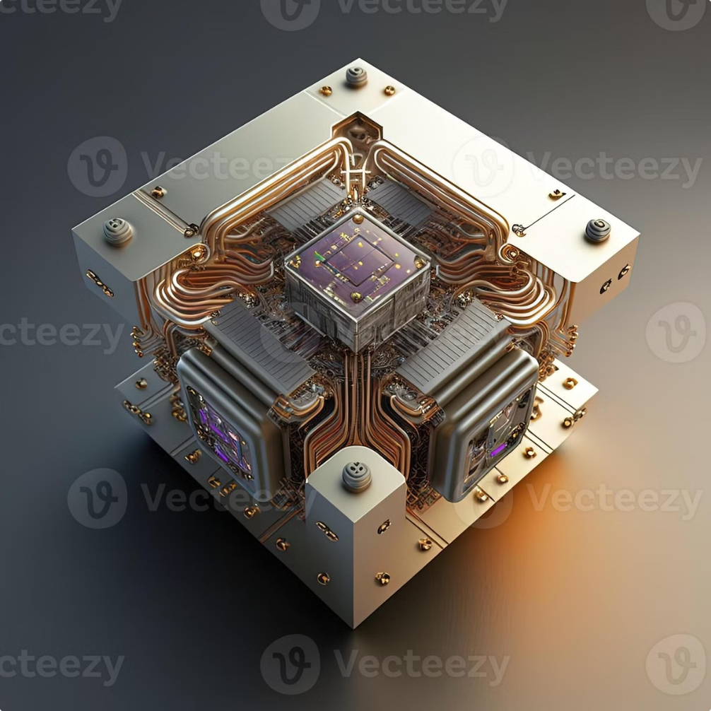
Quantum Computing: The Next Frontier
Quantum computing harnesses the bizarre laws of quantum mechanics to solve problems beyond classical computers. This revolutionary technology promises to transform industries and unlock new scientific discoveries.
VEPUR ANURAG REDDY – 22071A6763

Slide 2

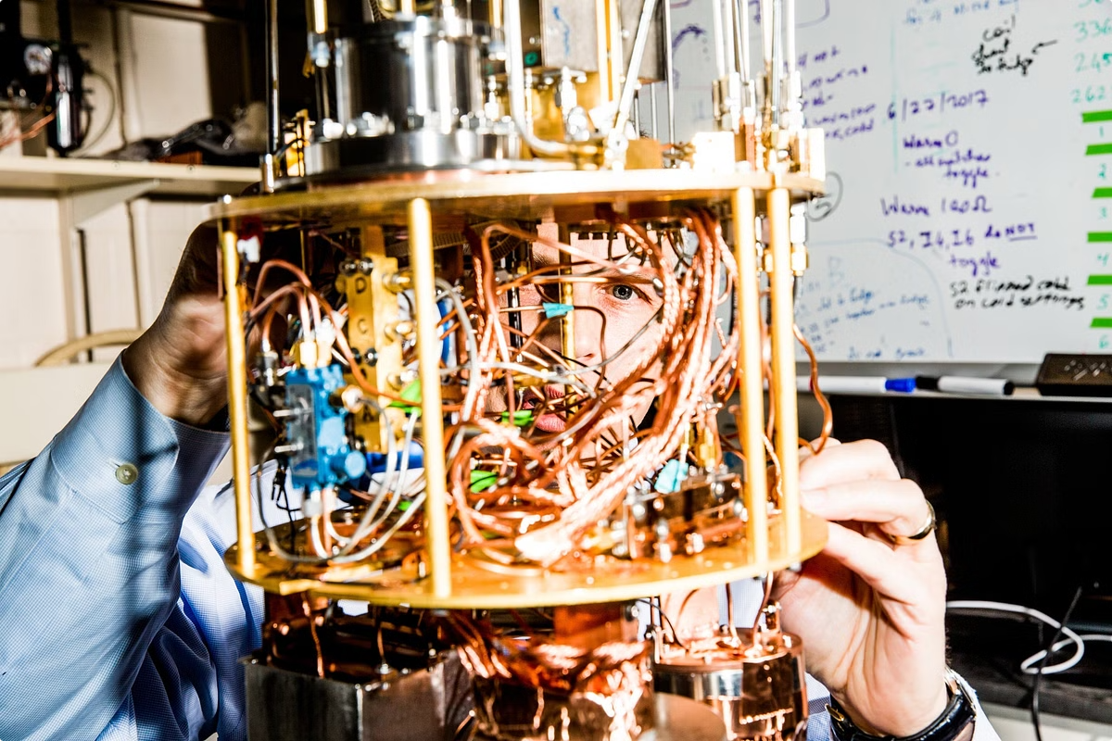
What is Quantum Computing?
Definition
Key Concepts
Quantum computing uses quantum mechanical phenomena to perform calculations exponentially faster than classical computers.
Utilizes quantum bits (qubits) and quantum effects like superposition and entanglement.
Potential
Promises breakthroughs in cryptography, drug discovery, financial modeling, and artificial intelligence.

Slide 3

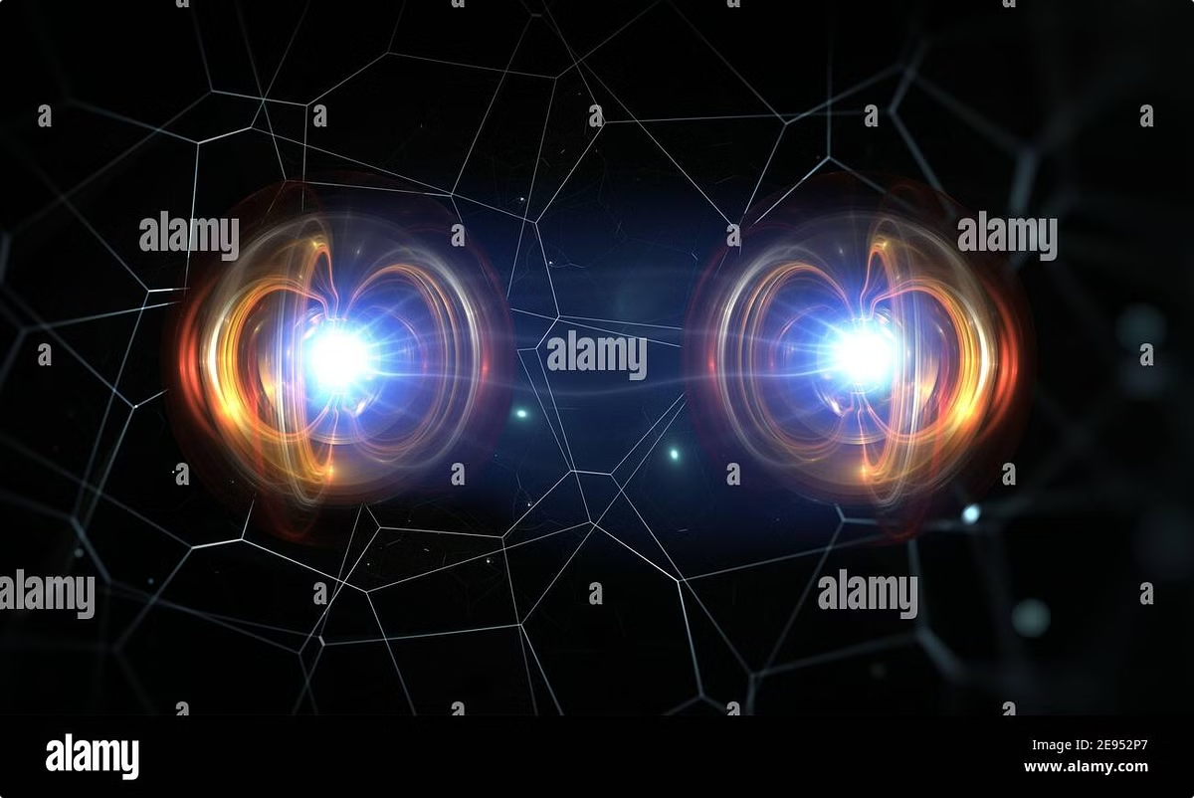
Principles of Quantum Mechanics
1
Superposition
Particles can exist in multiple states simultaneously until observed.
2
Entanglement
Particles become interconnected, sharing correlated properties regardless of distance.
3
Wave-Particle Duality
Matter and energy exhibit properties of both waves and particles.

Slide 4

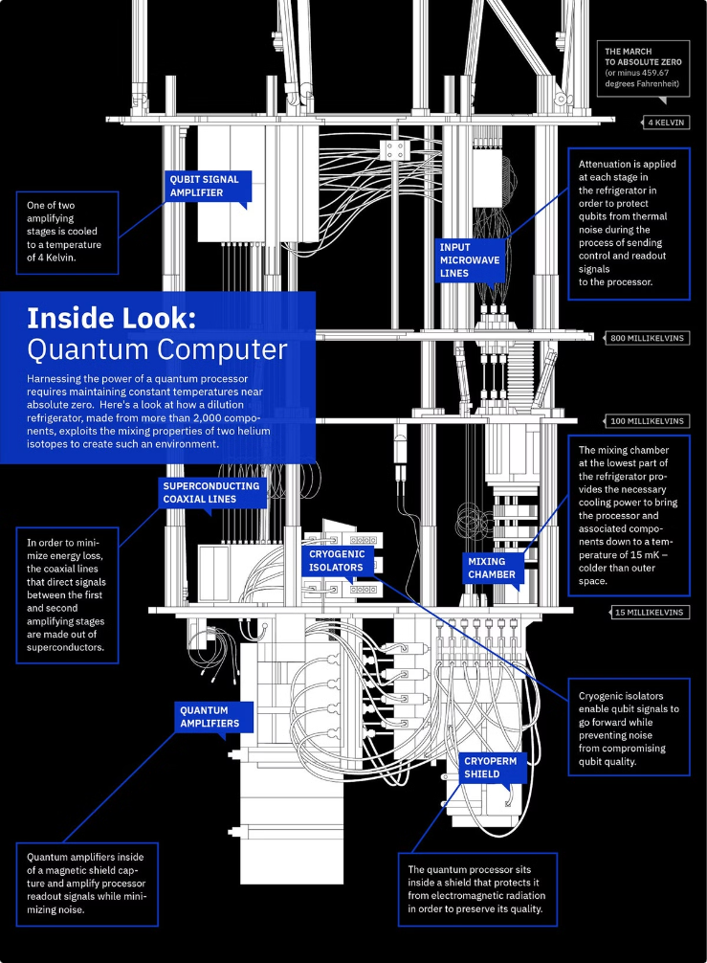



How Does This Work?
Initialization
Qubits are prepared in a superposition of states.
Quantum Gates
Operations manipulate qubits, exploiting quantum effects.
Measurement
Qubits are observed, collapsing into classical states.

Slide 5
Quantum Bits (Qubits) and Superposition
Classical Bits
Qubits
Quantum Advantage
Store information as 0 or 1.
Can exist as 0, 1, or both simultaneously due to superposition.
Enables exponential increase in computational power.

Slide 6

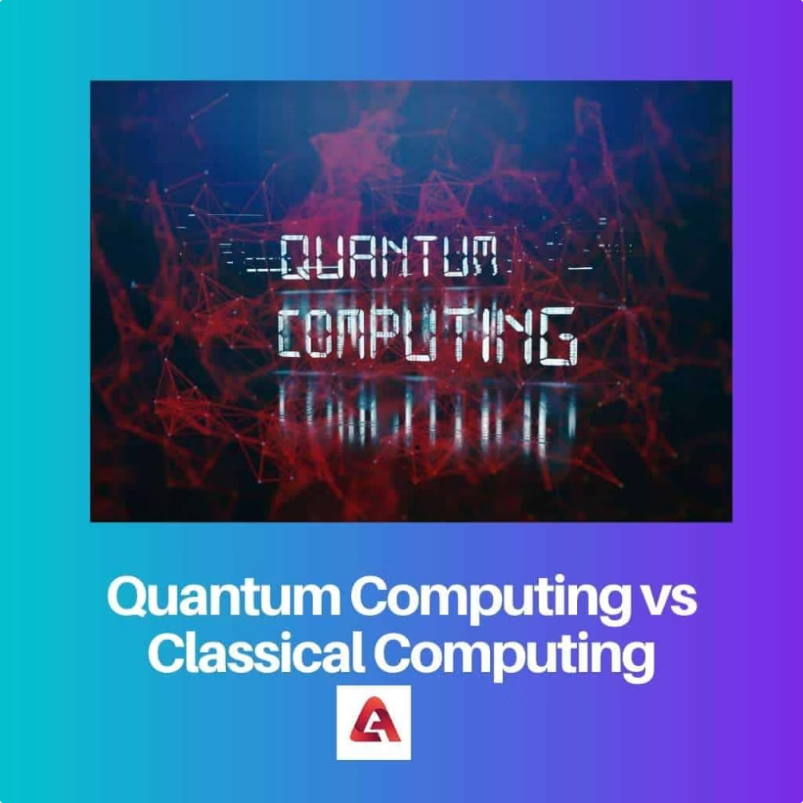
Classical vs Quantum Computing
Property
Classical
Quantum
Basic Unit
Bit
Qubit
States
0 or 1
Superposition
Processing
Sequential
Parallel

Slide 7

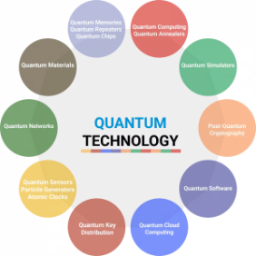
Applications of Quantum Computing
Drug Discovery
Materials Science
Simulating molecules to design new drugs and therapies.
Understanding the behavior of materials at the atomic level.
Financial Modeling
Artificial Intelligence
Developing complex financial models and optimizing investment strategies.
Improving machine learning algorithms for image recognition, natural language processing, and more.

Slide 8

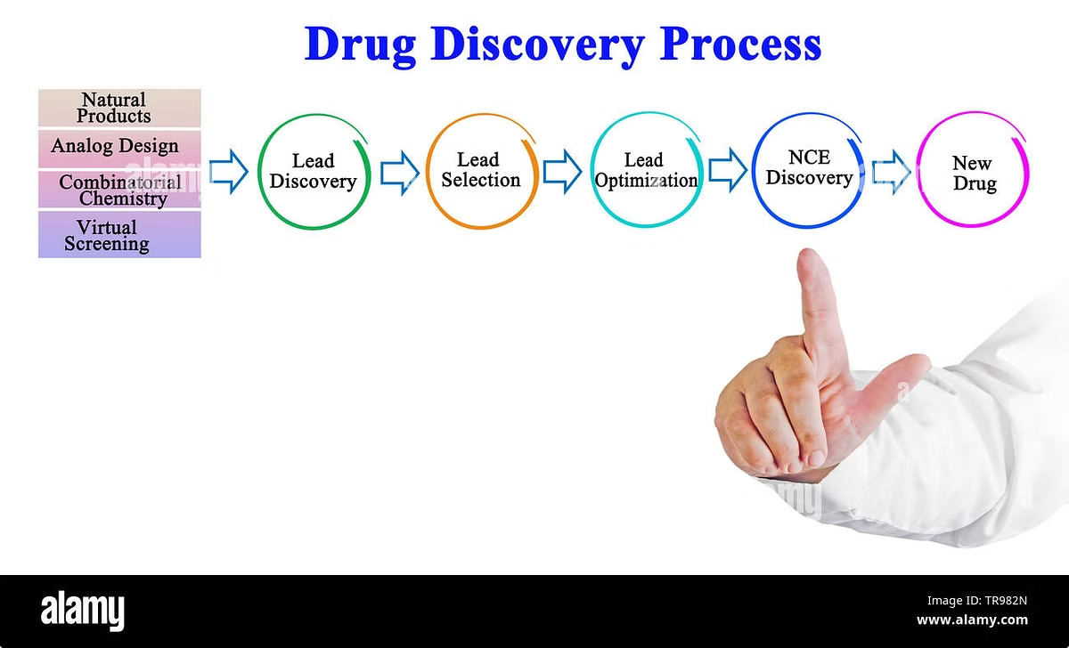
Drug Discovery
Target Identification
Identifying proteins or pathways involved in a disease.
Lead Optimization
Finding and refining potential drug candidates.
Clinical Trials
Testing the drug's safety and effectiveness in human subjects.

Slide 9





Cyber Security
Quantum Key Distribution
Securely distributing encryption keys using quantum principles.
Post-Quantum Cryptography
Developing encryption algorithms that are resistant to quantum attacks.
Quantum Network Security
Ensuring the security of quantum communication networks.

Slide 10

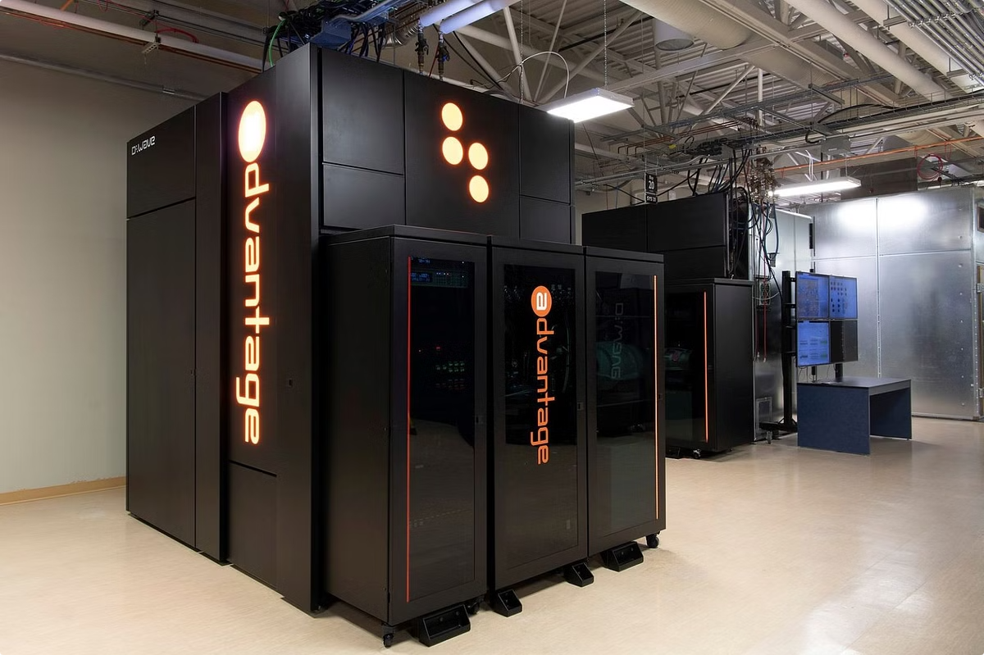
The Future of Quantum Computing
Quantum computing is still in its early stages, but it has the potential to revolutionize many industries. As quantum computers become more powerful and accessible, we can expect to see even more groundbreaking applications.

Slide 11


Conclusion
Quantum computing is a transformative technology with the potential to revolutionize various industries and solve some of the world's most challenging problems. While still in its early stages, quantum computing is rapidly evolving, and its impact is poised to be profound.

